Slide 1
chAirBear2
How to survive at Moffitt Library

Slide 2
Goal
Notify available seats in the libraries in the real-time.
Recommend the best time to go to the library that you can grab your seat with the highest possibility.
Displays the number of people in the libraries
Tells you when the libraries are opened or closed

Slide 3
How did we build?
We built chAirBears2 using ImageAI, YOLO, and Cisco WebEx.
ImageAI and YOLO were for the object detection, and Cisco WebEx was used for ChatBot.
We determined the available seats using our own heuristic function, JSONified and sent this information to our ChatBot so that users can retrieve the real-time library information. Our ChatBot was trained based on keyword training.

Slide 4

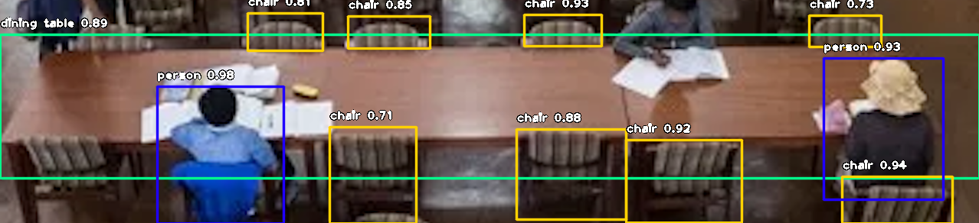
Object Detection

Slide 5
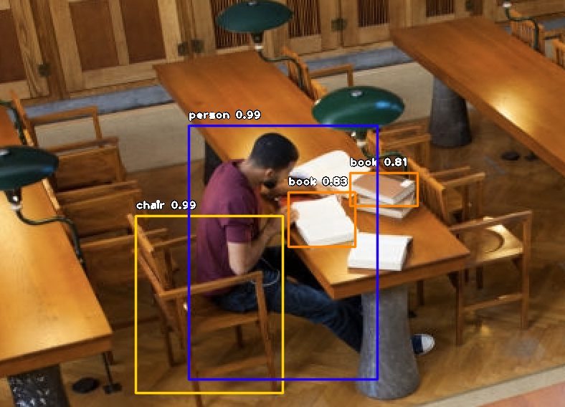
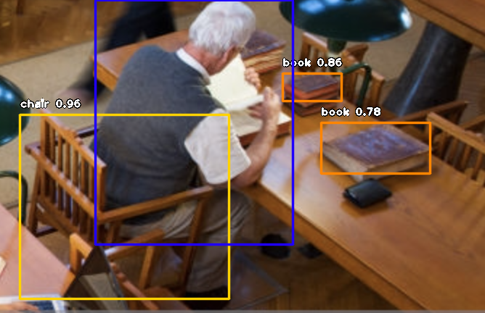
Object Detection

Slide 6
Object Detection
We focus on detecting the people, chair, laptop, bags and books in one table.
If there are laptop or books in front of seat, we assume that the seat is occupied.
If there are small stuff such as smart phone, water bottle, we gave small points for each. If sum of points is greater than 0.8, we assume that the seat is occupied.
Then we count the number of empty seats, and the total number of people in library. And we sent the data to chatbot to deal with this information.

Slide 7
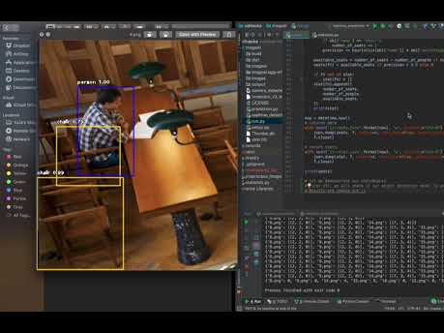
Object Detection

Slide 8
CISCO – WEBEX teams
WebEX Teams is an app for continuous teamwork with video meetings, group messaging, file sharing and white boarding.
We use the chatbot in WebEX to notify the current situation of library.
We trained the chatbot to react specific words.
We expect that students can easily get information of remain seats by using WebEX teams application.

Slide 9
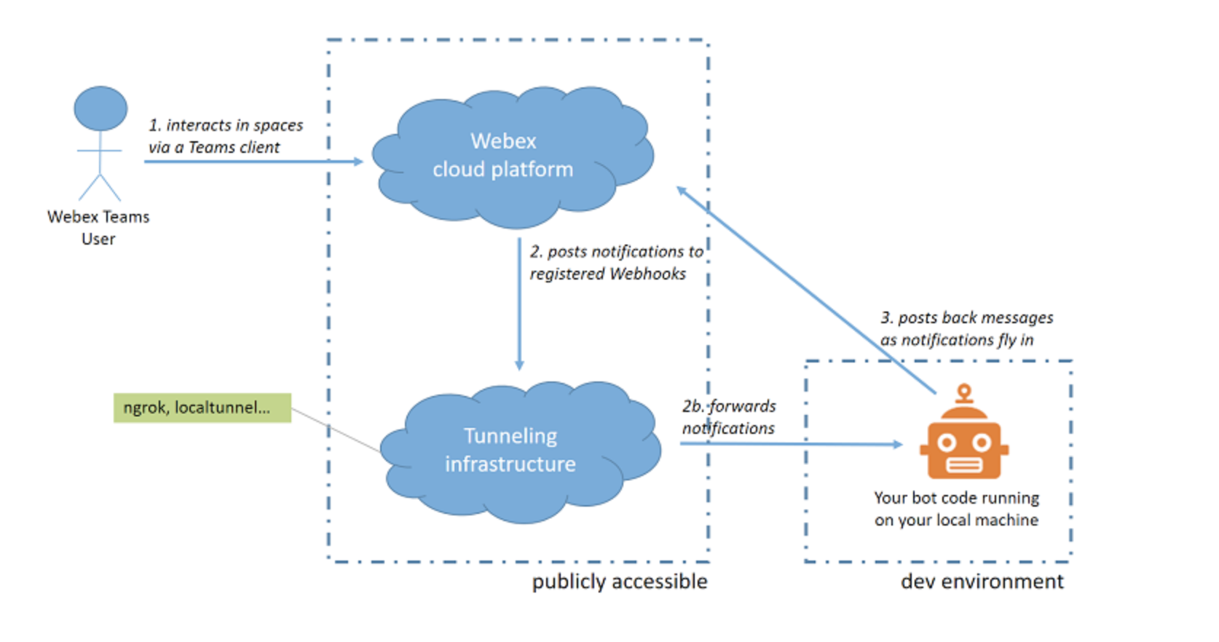
How to run CHAtBOt

Slide 10
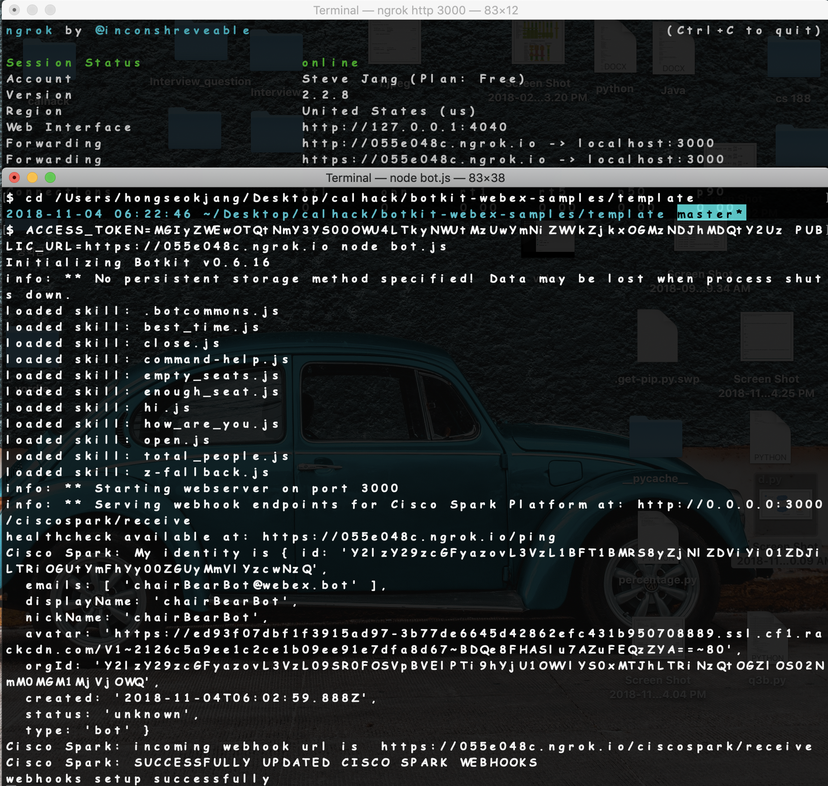

Slide 11
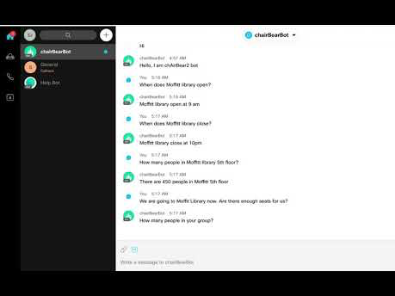
DEMO

Slide 12
What is our future plan?
Take a lot of pictures in the libraries so that we can improve the performance of object detection model.
Crop photo automation. Since we were not able to complete the crop automation (for the better precision), we could not achieve decent precision with different images of libraries. Therefore, we cropped images manually to improve the detection performance, which is highly inefficient. We will automate this process so that we can guarantee the highest precision regardless of image quality.
Live streaming of JSON data from the backend side to WebEx Chatbot so that we don’t have to manually upload the JSON files.
Build a robust statistical-based model that includes: noise level, number of students depending on time and libraries, and so on.
Using this statistical model, we can expect:
• the best and worst time to go to the library
• library recommendation module depending on the students' preference

Slide 13
Thank you

